Slide 1
OEE Tool Documentation v1

Slide 2
Base Calculations/Definitions

Slide 3
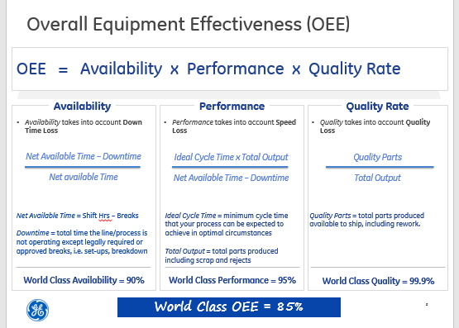

Slide 4
Data

Slide 5
OEE Calculations
Poor Man’s OEE – Data Mapping
Spotfire Visualization
Uses Site_code
Aviation Sites Lat & Long
OEE Panel View
Site, Asset Number, Machine Group, Loading Factor, Part Number, Operation, Net Available Time, Cycle Time, FW, Total Qty, Qty Non-CF, Downtime
CSF
– uses aggregated view in adv_analytics
Site
Part Number
Operation
FW, FY, Dates
Total Qty (qty_claimed)
Qty Non-CF
Manual Machine Group Lookup Table
Machine Group
Net Available Time
Maximo
Downtime
Uses Asset Number
Manual Asset Lookup Table
Asset Number
Cycle Time
Uses Part & Op
Uses Asset Number
BDW
FW date begin
FW date end
Uses FY & FW

Slide 6
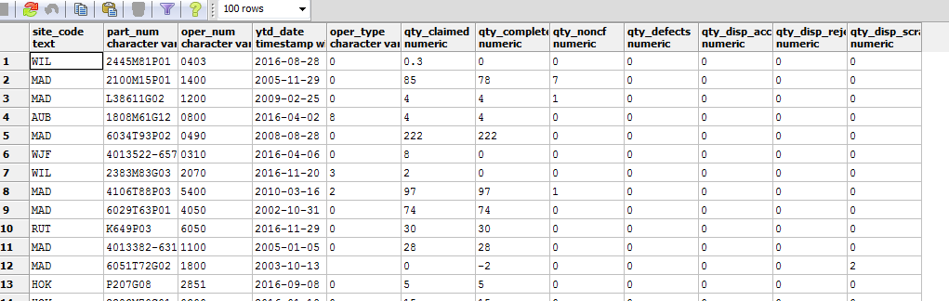
Geagp_dl_adv_analytics.ytd_throughput_view

Slide 7
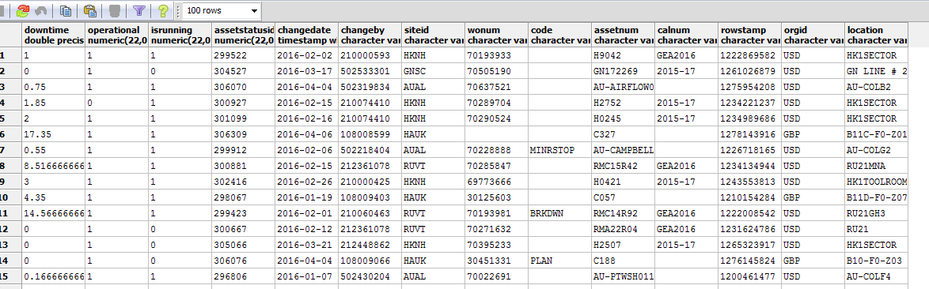
Geagp_maximorep.maximorep_assetstatus_mv

Slide 8
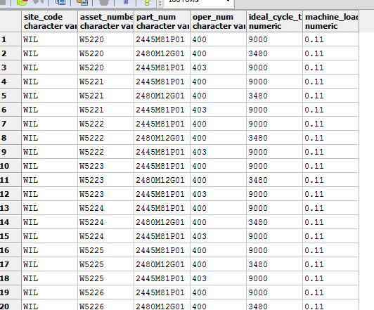
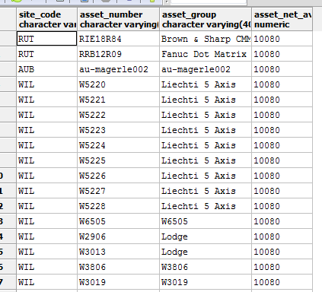
Geagp_dl_adv_analytics
ia_asset_oper_lkp
ia_site_asset_group_lkp

Slide 9
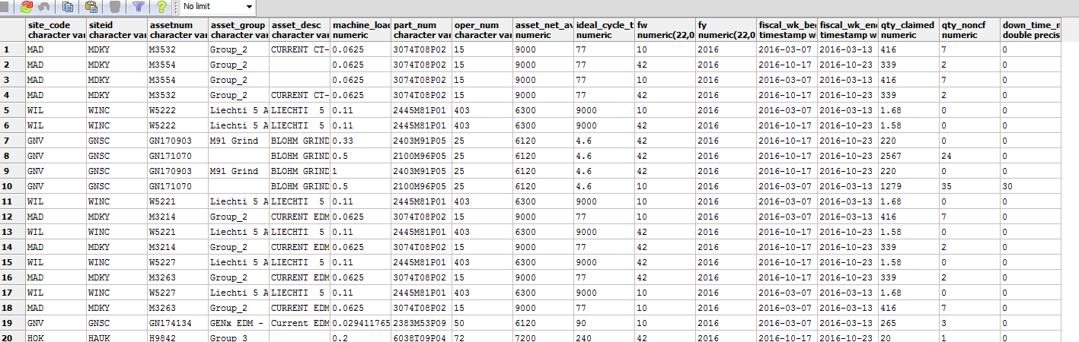
Geagp_dl_adv_analytics.ia_oee_panel_view

Slide 10
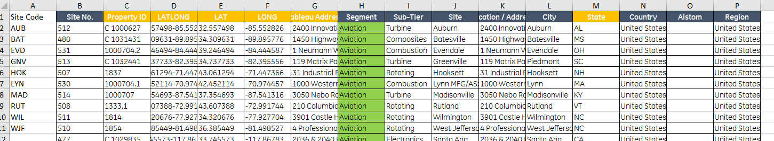
Aviation Sites Lat & Long (excel stored locally in Spotfire)

Slide 11
Visualization

Slide 12
Calculated Columns in Spotfire
Machine = case when [site_code] = '${Site}' then [assetnum] end
Availability = Sum([asset_net_avail_time] - [down_time_min]) over ([fw],[fy],[asset_group],[site_code]) / Sum([asset_net_avail_time]) over ([fw],[fy],[asset_group],[site_code])
Performance = Sum([ideal_cycle_time] * [qty_claimed] * [machine_loading]) over ([fw],[fy],[asset_group],[site_code]) / ((UniqueCount([assetnum]) OVER ([fw],[fy],[asset_group],[site_code]) * 10080) - Sum([down_time_min]) OVER ([fw],[fy],[asset_group],[site_code]))
Quality Rate =Sum([qty_claimed] - [qty_noncf]) over ([fw],[fy],[asset_group],[site_code]) / Sum([qty_claimed]) OVER ([fw],[fy],[asset_group],[site_code])
OEE = [Availability] * [Performance] * [Quality Rate]
YTD Availability = If(Date([fiscal_wk_begin])<=DateAdd("Week",-1,DateTimeNow()),Sum([asset_net_avail_time] - [down_time_min]) over ([fy],[asset_group],[site_code]) / Sum([asset_net_avail_time]) over ([fy],[asset_group],[site_code]),0)
WK Downtime = Sum([down_time_min]) over ([fw],[fy],[assetnum],[site_code])

Slide 13
Calculated Columns in Spotfire (cont)
YTD Performance = If(Date([fiscal_wk_begin])<=DateAdd("Week",-1,DateTimeNow()),Sum([ideal_cycle_time] * [qty_claimed] * [machine_loading]) over ([fy],[asset_group],[site_code]) / Sum([asset_net_avail_time] - [down_time_min]) over ([fy],[asset_group],[site_code]),0)
YTD Quality Rate = If(Date([fiscal_wk_begin])<=DateAdd("Week",-1,DateTimeNow()),Sum([qty_claimed] - [qty_noncf]) over ([fy],[asset_group],[site_code]) / Sum([qty_claimed]) OVER ([fy],[asset_group],[site_code]),0)
YTD OEE = [YTD Availability] * [YTD Performance] * [Quality Rate YTD]
YTD Downtime = If([fw]<>(Week(DateTimeNow()) - 2),Sum([down_time_min]) over ([fy],[assetnum],[site_code]),0)
Last 4 WK Availability = If((Date([fiscal_wk_begin])>=DateAdd("Week",-5,DateTimeNow())) and (Date([fiscal_wk_begin])<=DateAdd("Week",-1,DateTimeNow())),Sum([asset_net_avail_time] - [down_time_min]) over ([fy],[asset_group],[site_code]) / Sum([asset_net_avail_time]) over ([fy],[asset_group],[site_code]),0)

Slide 14
Calculated Columns in Spotfire (cont)
Last 4 WK Performance = If((Date([fiscal_wk_begin])>=DateAdd("Week",-5,DateTimeNow())) and (Date([fiscal_wk_begin])<=DateAdd("Week",-1,DateTimeNow())),Sum([ideal_cycle_time] * [qty_claimed] * [machine_loading]) over ([fy],[asset_group],[site_code]) / Sum([asset_net_avail_time] - [down_time_min]) over ([fy],[asset_group],[site_code]),0)
Last 4 WK Quality = If((Date([fiscal_wk_begin])>=DateAdd("Week",-5,DateTimeNow())) and (Date([fiscal_wk_begin])<=DateAdd("Week",-1,DateTimeNow())),Sum([qty_claimed] - [qty_noncf]) over ([fy],[asset_group],[site_code]) / Sum([qty_claimed]) OVER ([fy],[asset_group],[site_code]),0)
Last 4 WK OEE = [Last 4 WK Availability] * [Last 4 WK Performance] * [Last 4 WK Quality]
Quality Loss = [qty_noncf] * [ideal_cycle_time]
Performance Loss = (1 - [Performance]) * [asset_net_avail_time]
Productive Time = ([qty_claimed] - [qty_noncf]) * [ideal_cycle_time] * [machine_loading]

Slide 15
Spotfire Data Join
Added columns to OEE data table from imported Aviation Sites Lat & Long excel file – matched on Site Code =site_code
City
Country
LAT
LONG
Site
State
Sub-Tier

Slide 16
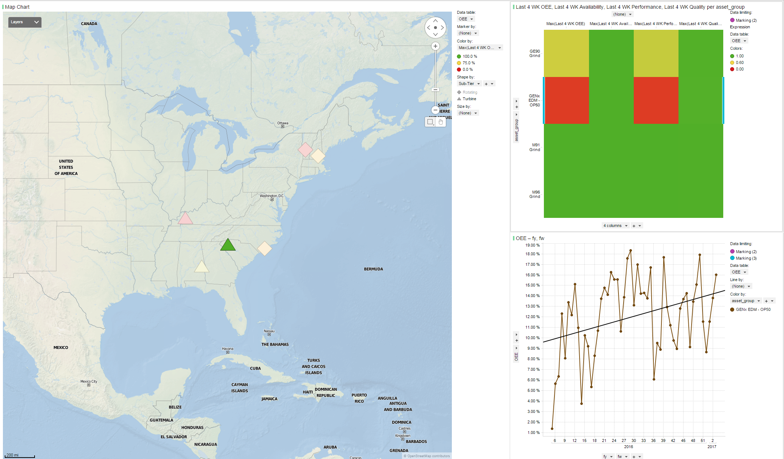
Color based upon:
Max (Last 4 WK OEE)
Limited by marking on map
Shapes are by Sub - Tier
Columns are:
Max (Last 4 WK OEE)
Max (Last 4 WK Availability)
Max (Last 4 WK Performance)
Max (Last 4 WK Quality)
Points at lat, long on map
Limited by marking on map & Heat map

Slide 17
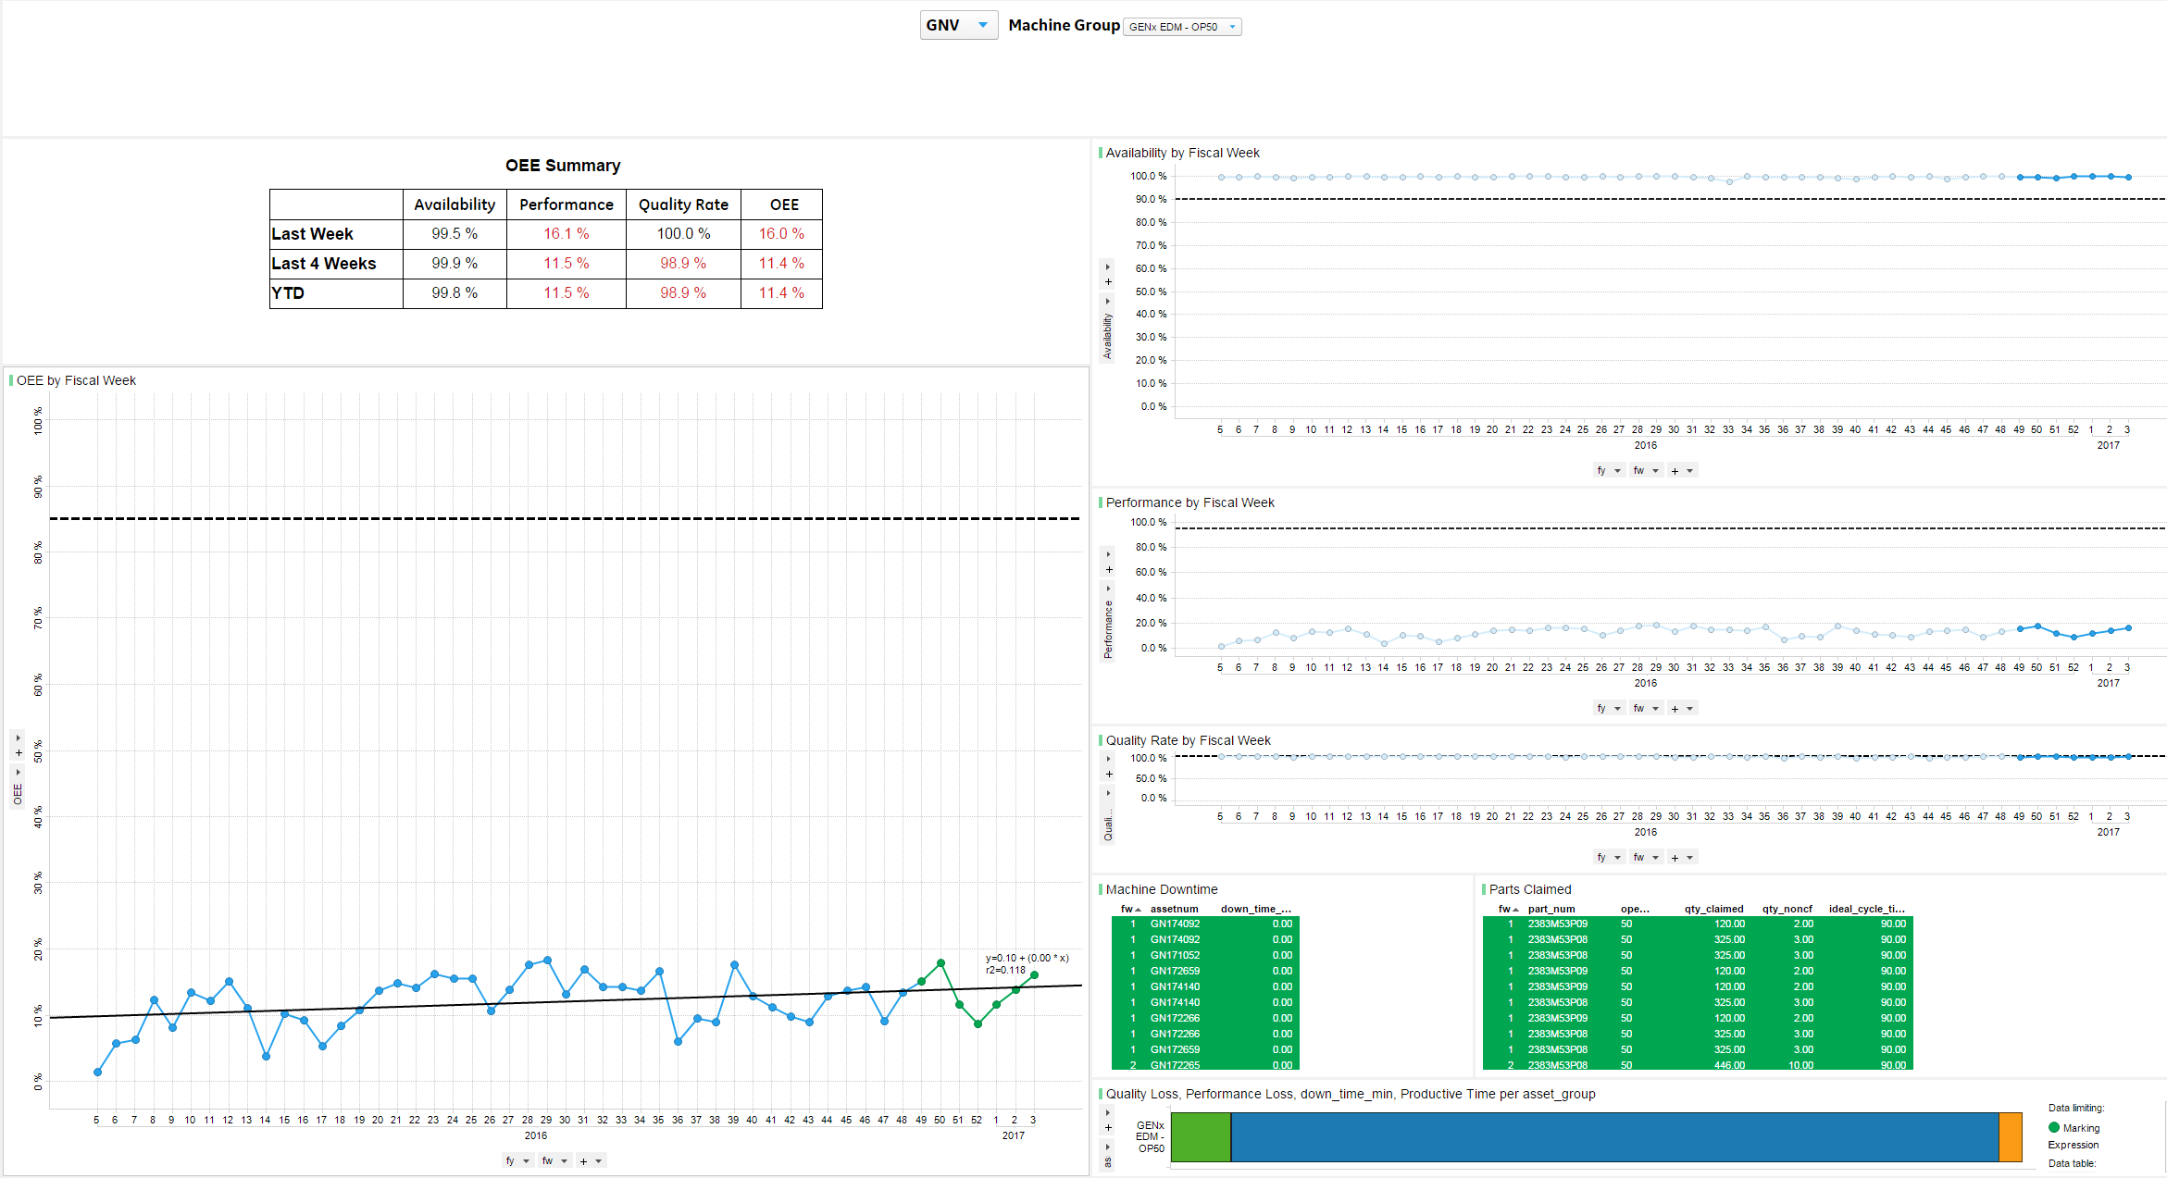
Site_code filter
Asset_group filter
Each box is a controlled field using the calculated column for that
(eg: Last Week Availability)
All charts/tables on right are limited by marking from OEE chart on left
Availability by FY,FW limited to 52 week view
Performance by FY,FW limited to 52 week view
OEE by FY,FW limited to 52 week view
Quality by FY,FW limited to 52 week view
Fw,
assetnum, down_time_min
FW,
Part_num
Oper_num
Qty_claimed
Qty_noncf
Stacked bar chart: Sum(Quality Loss), Sum(Performance Loss), Sum (down_time_min), Sum (Productive Time)

Slide 18
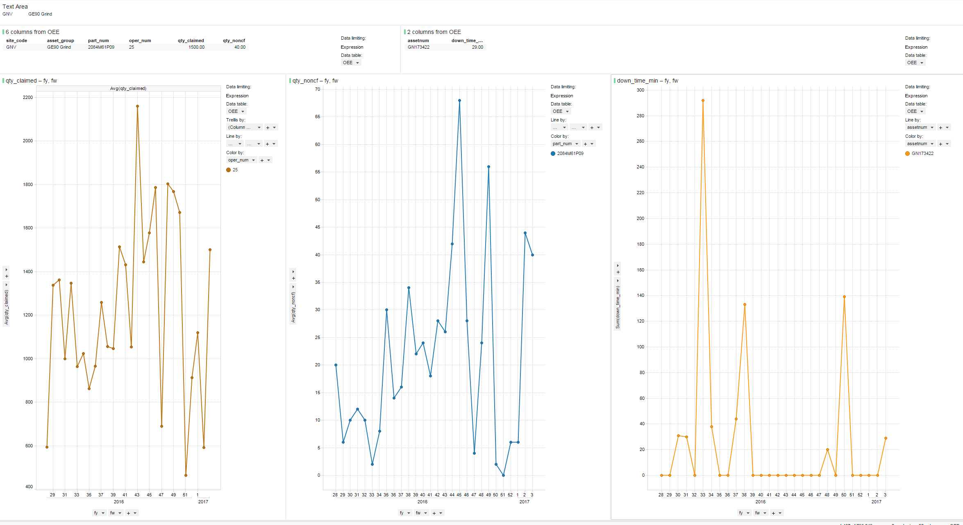
Data limited to Site_code & Asset_group from previous page & Last week
Avg(qty_claimed) by FY,FW limited to 25 week view
Sum(down_time_min) by FY,FW limited to 25 week view
Avg(qty_noncf) by FY,FW limited to 25 week view

Slide 19
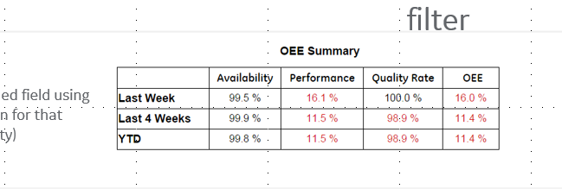
Summary Table Filters
Data Limiting for Last Week Row →'${Machine}' = [asset_group] and [site_code] = '${Site}' and Date([fiscal_wk_end])>=DateAdd("Week",-1,Date(DateTimeNow())) and Date([fiscal_wk_begin])<=DateAdd("Week",-1,Date(DateTimeNow()))
Data Limiting for Last 4 Week Row →'${Machine}' = [asset_group] and [site_code] = '${Site}'
Data Limiting for YTD Row →'${Machine}' = [asset_group] and [site_code] = '${Site}' and [fy] = Year(DateTimeNow())

Slide 20
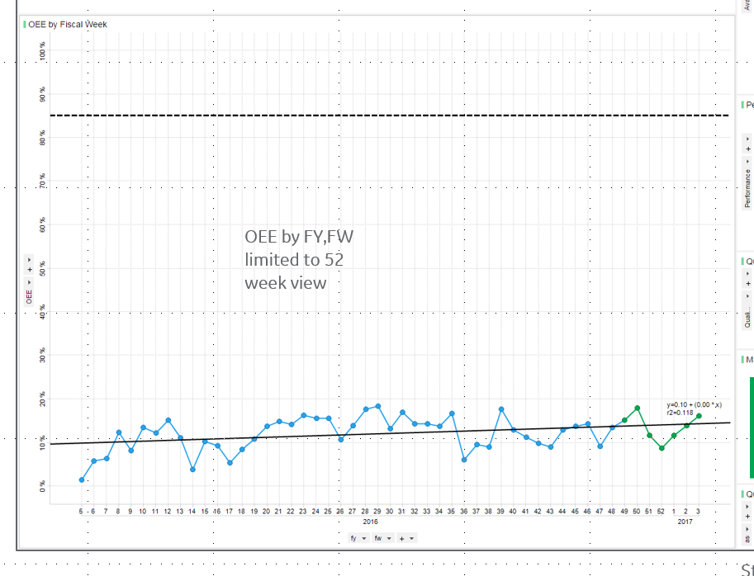
Line Chart (all 4) Data Filter
'${Machine}' = [asset_group] and [site_code] = '${Site}' and Date([fiscal_wk_end])>=DateAdd("Week",-51,Date(DateTimeNow()))

